Slide 1
E-Commerce website Software Development Plan
Bookings.com
Keoagile Motlhale
Last Updated:
16 may 2018

Slide 2
Project Overview:
This Project is to help members book out their holidays in advance. Travelling to a place can be a stressful process as having to find different websites for different services but Booking.com covers all of that on one domain and this will take up all of the unnecessary processes of finding accommodation, flights ,car rentals taxis.
Booking.com aims to allows the user to book for accommodation, car rentals, flights, airport taxis and restaurants and it compares prices for cheaper alternatives.

Slide 3
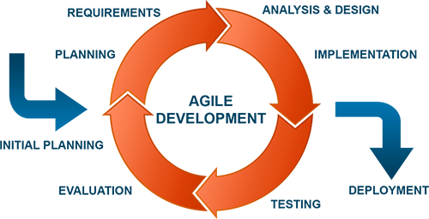
Software Development Life Cycle:
We will be using the Agile Development life cycle as it allows for working with customers interactions, collaborating with the customer and allows us to respond to the change of the customer’s requirements very easily. It allows for the continual support of the project for updating and maintenance.

Slide 4
Planning
In the planning phase we will conduct a contact session where the business representatives comes in and we discuss what are the tasks the website must perform and how must it complete the task and how the system.
A random user will also have a contact session to discuss from a user’s perspective what the system needs to be able to do to help the user and which features to add to make it more user friendly

Slide 5
Implementation
During this phase all the information gathered in the contact sessions with the representative of the business and the random user will be implemented
I will start with the analysis of the user requirements, design and implement each module based on the user requirements

Slide 6
Testing & Evaluation
In this phase each requirement will be tested and evaluated individually to make it more efficient robust and user friendly to ensure the best product will be deployed
The application will be introduced to end users for testing. At this time they will be providing feedback and clarify the needs of the user requirements as per needed

Slide 7
Deployment
This is the last phase of the life cycle as the application will be developed and finalised for each requirement and the product will be ready for deployment and used by the end user

Slide 8
Project Overview: User Requirements
The user needs to be able to register for a membership and login if they not already registered
The user does not need to be a member to use the website, they can book without registering
List their property on the site for booking, manage their property information
Manage their information
Search for accommodation
Book for accommodation
Make payments

Slide 9
Project Overview: Hotel Manager Requirements
The hotel manager needs to be able to register for a membership and login if they not already registered
The manager must be able to view all the rooms on their hotel
Register a new hotel
Update hotel in formation
Upload images of the hotels

Slide 10
Project Overview: Admin Requirements
The Admin must be to view all hotels and rooms registered on the site, all the users, reviews, and all the booking records done on the site
The admin must be able add remove and update all the booking records.

Slide 11
Software Used for Development:
Build Tool: Visual Studio 2017
Source Management Tool: GitHub
Programming Language: C#, Html, JavaScript, Bootstrap, CSS and AngularJS, SQL
Server: MySQL
Unit Testing: Microsoft Unit Test Framework
Service: Web API,REST
Documentation: Swagger
Browser: Google Chrome, MS Edge, Firefox, Safari, Internet Explorer etc.

Slide 12
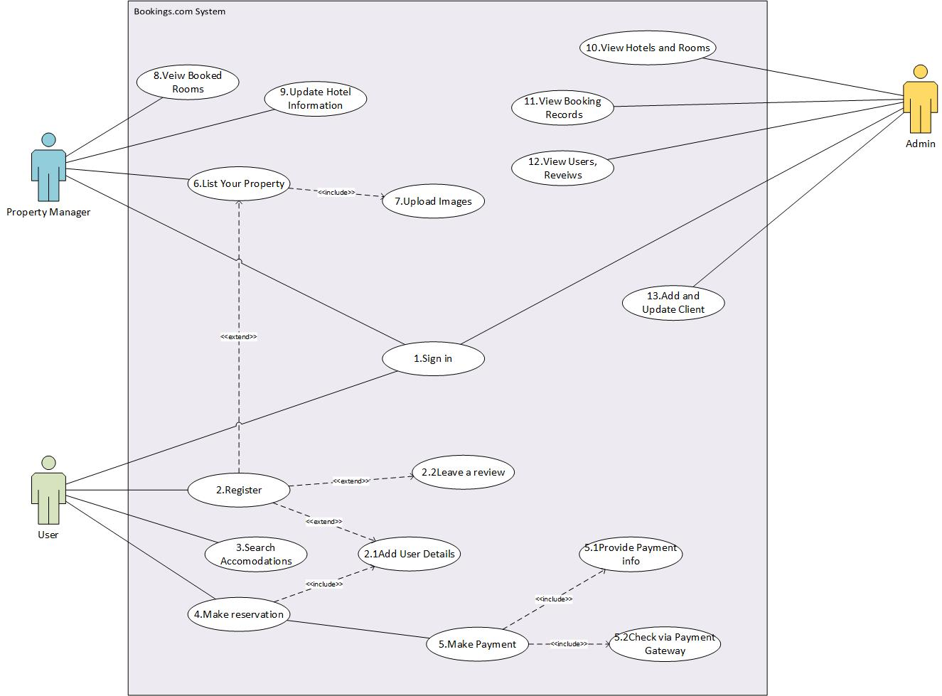
UML Diagrams: Use Case Diagram

Slide 13
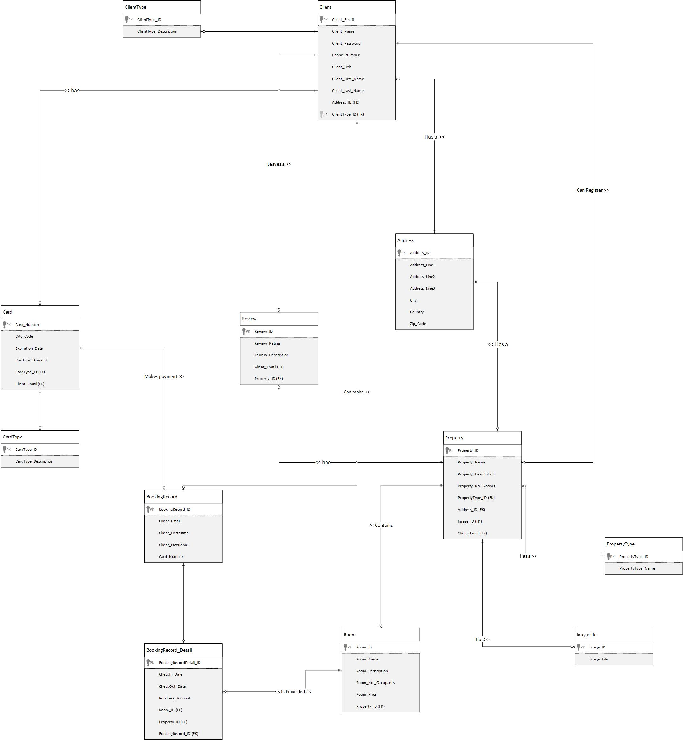
UML Diagrams: Entity Relationship Diagram

Slide 14
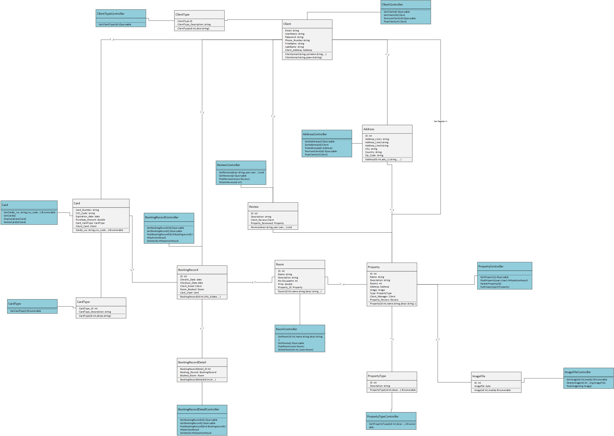
UML Diagrams: Class Diagram

Slide 15
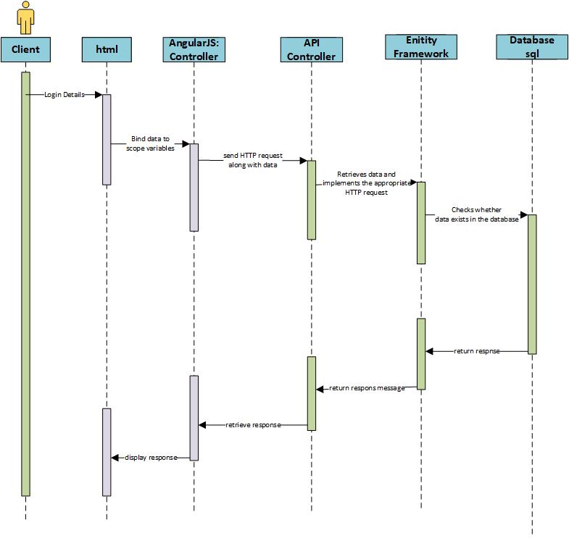
UML Diagrams: Sequence Diagrams

Slide 16
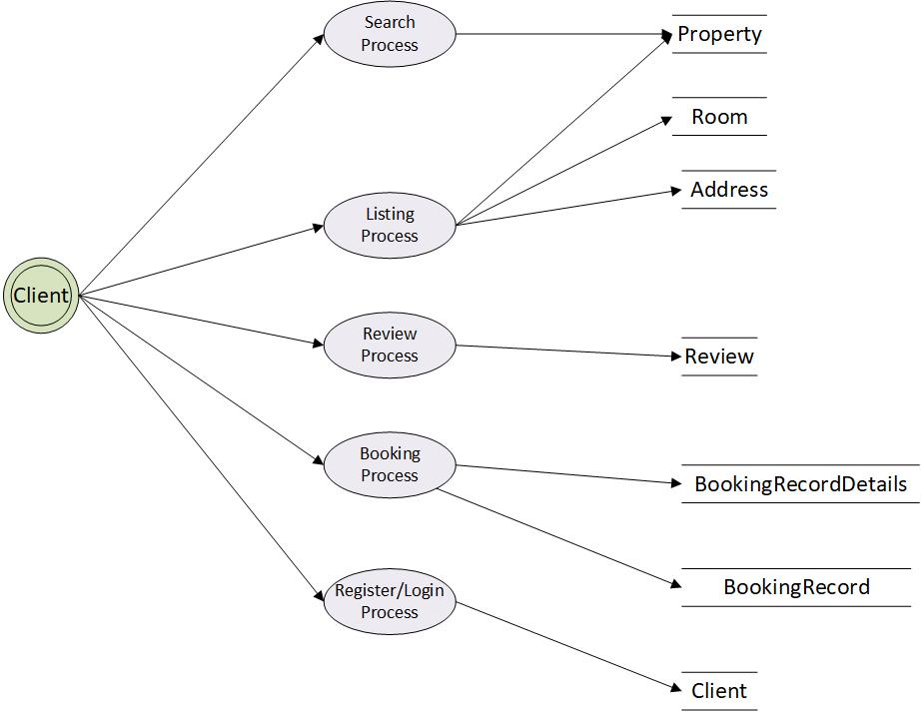
UML Diagrams: Data Flow Diagrams

Slide 17
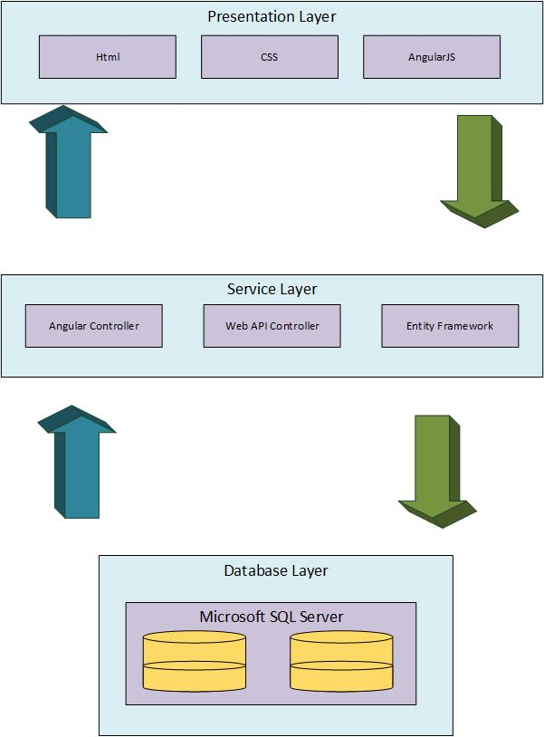
UML Diagrams: Architecture Diagram

Slide 18
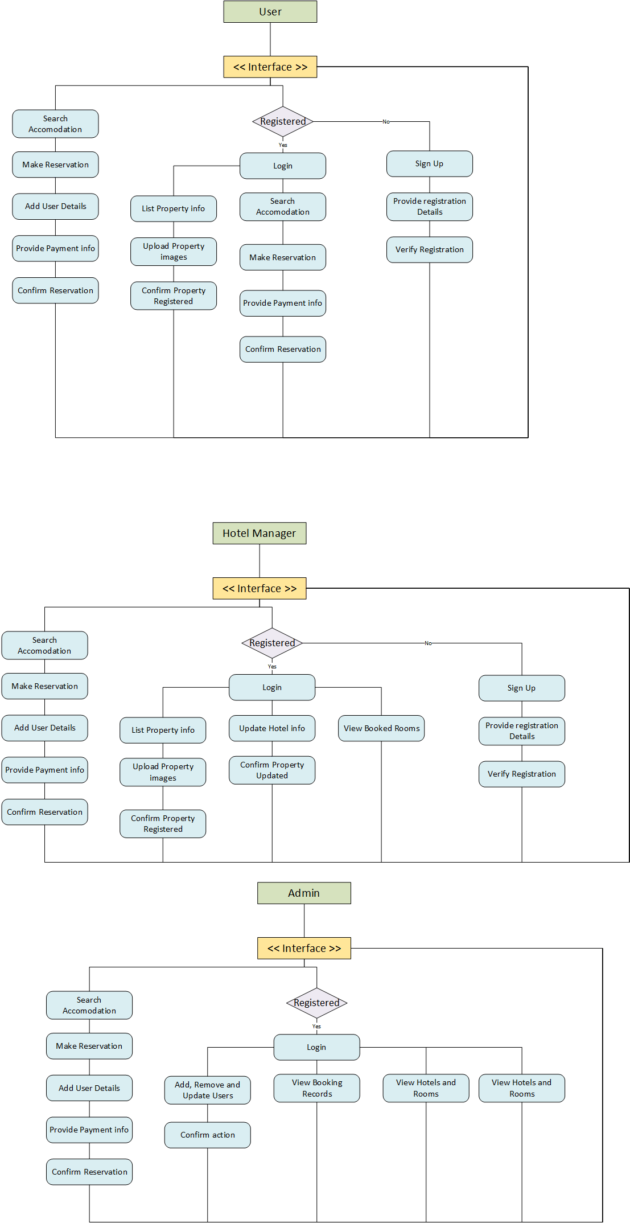
UML Diagrams: UI Diagrams

Slide 19
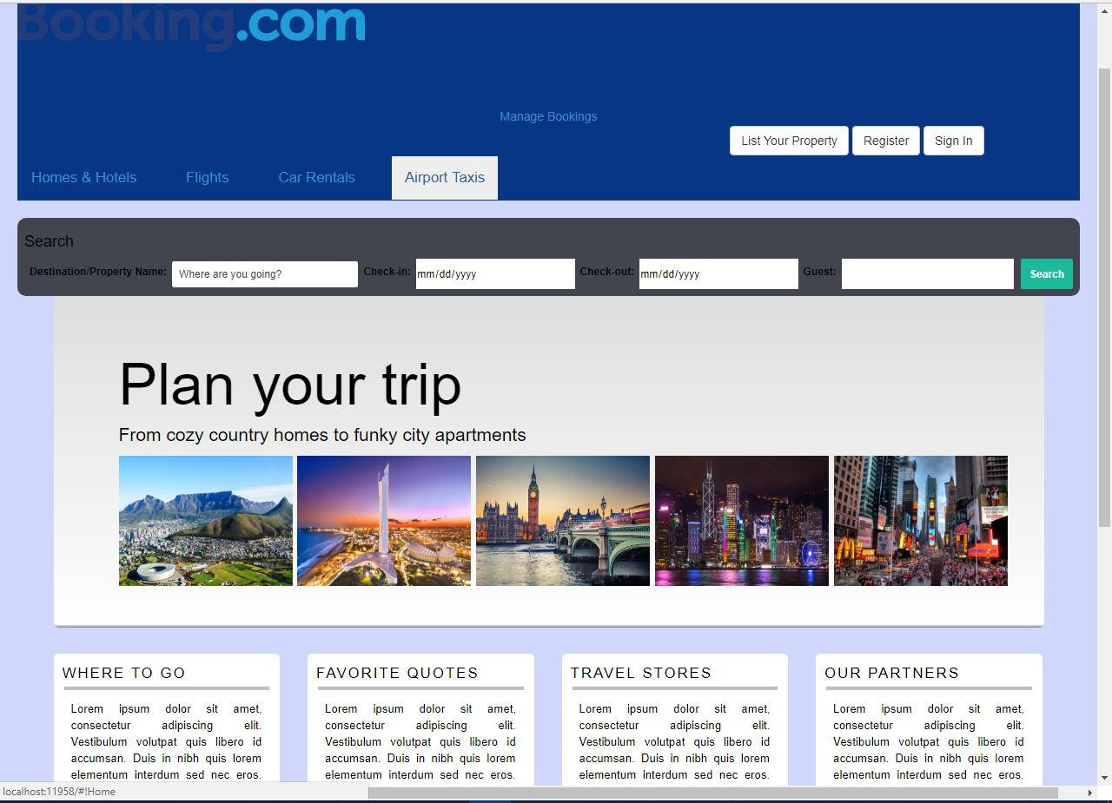
UML Diagrams: UI Diagrams

Slide 20
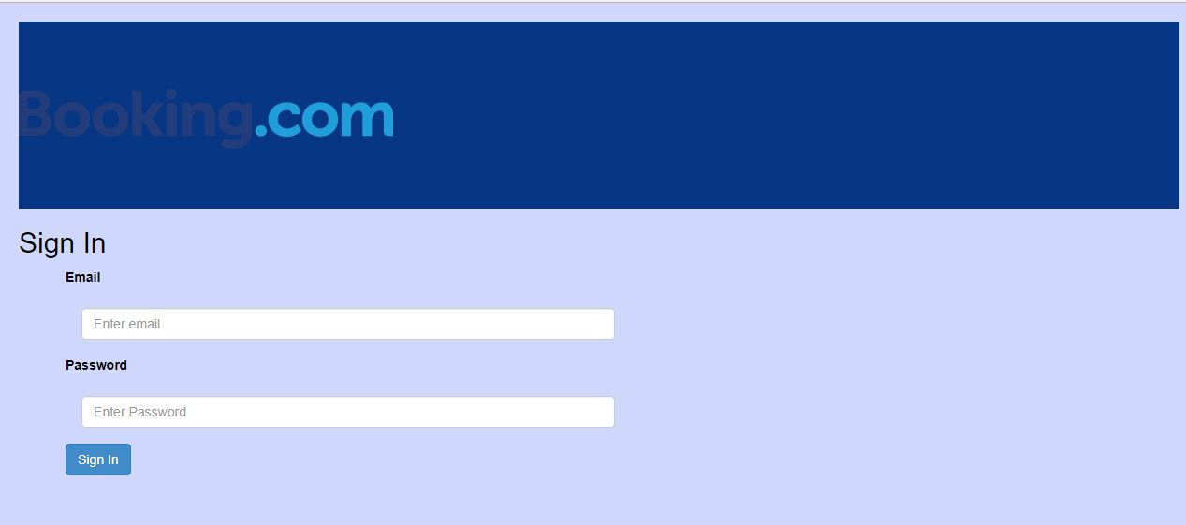
UML Diagrams: UI Diagrams

Slide 21
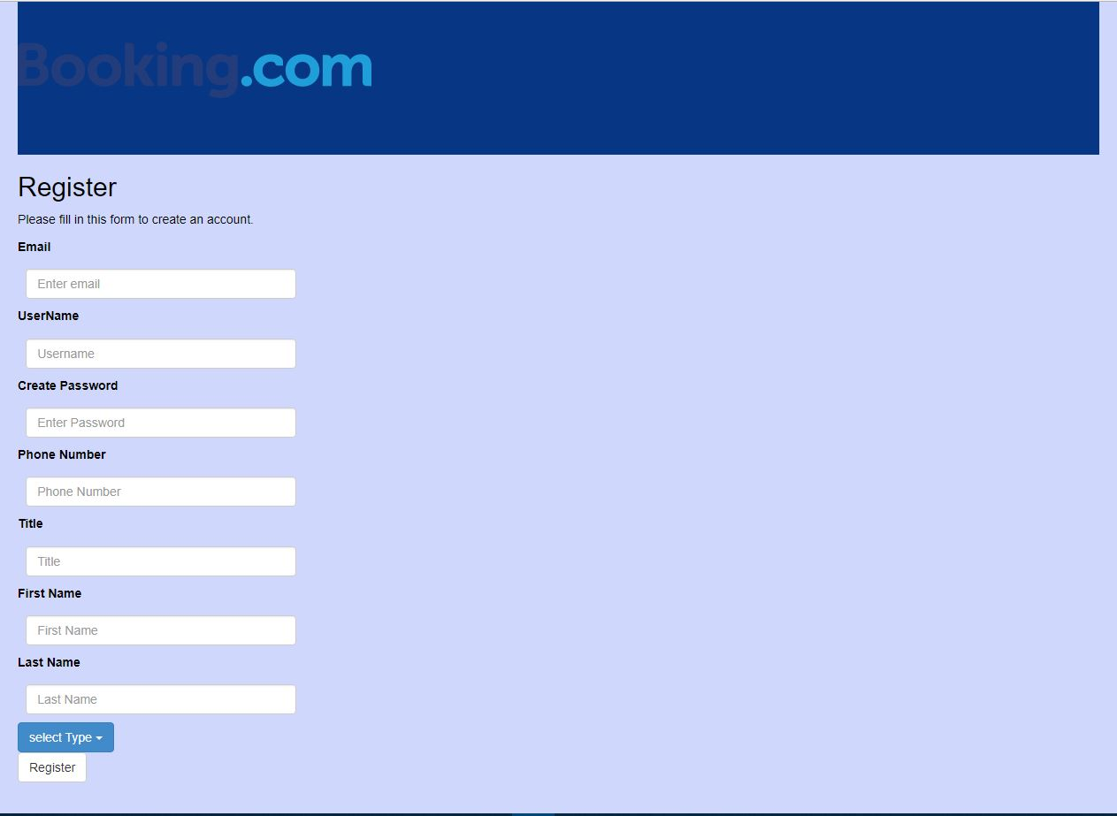
UML Diagrams: UI Diagrams

Slide 22
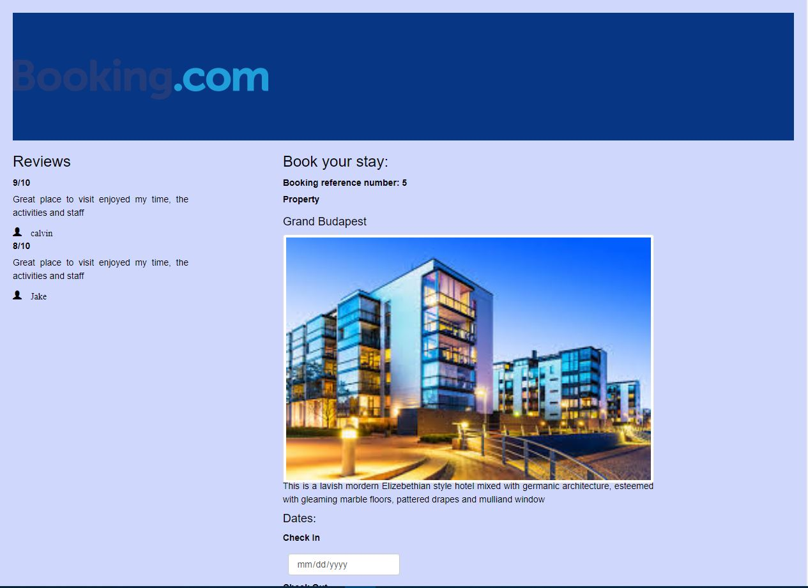
UML Diagrams: UI Diagrams

Slide 23
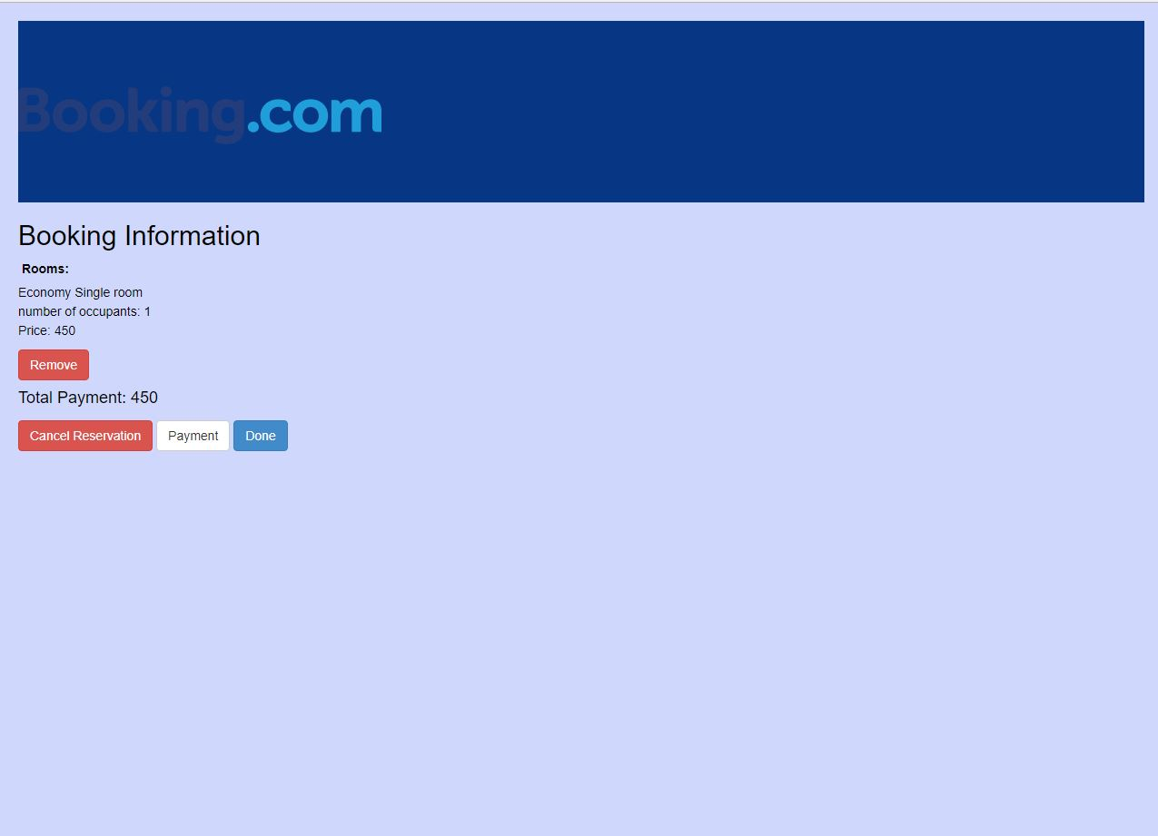
UML Diagrams: UI Diagrams

